Slide 1

AI & ML Presentation
AI/ML Driven 360° Client Intelligence
Presented by [Presenter Name Here]

Slide 2
Vision & Objective
Empowering Auditors with AI Insights
CONFIDENTIAL INFORMATION
2

Slide 3
Machine Learning Use Cases
The implementation of Machine Learning (ML) in auditing presents several key initiatives that transform traditional practices into more effective and proactive approaches.
Exposure & Collateral Risk Segmentation
Anomaly Detection & Early Warning
Predictive Credit Risk Scoring
Time-Series Forecasting
Collateral Valuation Drift
These initiatives focus on leveraging historical data to enhance risk management capabilities. For instance, anomaly detection allows for early identification of irregular patterns that may indicate potential risks. Predictive credit risk scoring aids auditors in assessing the likelihood of default, thereby facilitating informed decision-making. Additionally, time-series forecasting provides insights into future trends based on past behaviors, and collateral valuation drift enhances the accuracy of asset assessments over time. Collectively, these ML applications empower auditors with advanced tools for improved accuracy, efficiency, and insight in their processes.
Key initiatives for enhanced auditing
SUMMARY OF USE CASES
3

Slide 4
Artificial Intelligence Use Cases
The integration of Artificial Intelligence (AI) through Large Language Models (LLM) offers transformative opportunities in audit practices. Key use cases include:
Conversational Audit Assistant: Provides real-time support and answers during audits.
Automated Report Generation: Streamlines the creation of audit reports, ensuring consistency and accuracy.
Explainable AI Narratives: Generates clear narratives that explain complex findings in a comprehensible manner.
Document Intelligence: Analyzes and extracts relevant information from various documents, improving efficiency.
Scenario Simulation & Advisory: Enables auditors to simulate various scenarios and receive guidance based on data trends and insights.
These AI capabilities empower auditors to perform their tasks with greater precision, enhancing overall audit quality, reducing time spent on repetitive tasks, and enabling more informed decision-making.
Enhancing Audit Processes with LLM
ADDITIONAL INSIGHTS
4

Slide 5
Combined Cognitive Intelligence
The Combined Cognitive Intelligence approach merges machine learning and artificial intelligence to enhance audit processes. Key components include:
Cognitive Audit Dashboard: A centralized interface that visualizes audit data and insights.
End-to-End Confirmation Validation: Streamlined verification processes to ensure data accuracy.
Proactive Watchlists: Automated identification of high-risk clients and transactions for immediate attention.
Natural Language Data Discovery: Leveraging AI to facilitate intuitive querying and retrieval of information from datasets, making it accessible and user-friendly.
By combining these elements, auditors can achieve greater efficiency, accuracy, and insight-driven decision-making. This integrated system empowers audit teams to focus on strategic analysis rather than manual data handling, transforming the audit landscape into a more agile and proactive function within Standard Chartered Bank.
Integrating ML and AI for Audit
NOTES AND REFERENCES
5

Slide 6
Technical Architecture
The architecture for the AI/ML-driven 360° Client Intelligence platform consists of several key layers:
Data Ingestion Layer: This layer is responsible for aggregating data from various sources, including Excel, PDFs, and databases, ensuring a comprehensive data set for analysis.
ML Engine: Utilizing advanced techniques such as feature engineering, anomaly detection, and clustering to derive insights from the data, this engine forms the core of the intelligence framework.
AI/LLM Layer: Implementing LangChain and GPT models, this layer enables reasoning and reporting capabilities, enhancing the interpretability of audit results.
Visualization Layer: Using tools like Streamlit and Power BI, this layer provides intuitive dashboards to visualize data insights effectively.
Governance: Ensuring continuous learning and audit tracking, this aspect upholds the integrity and reliability of the entire system.
Overview of System Components
SYSTEM INSIGHTS
6

Slide 7
Expected Business Impact
60–70% faster anomaly detection
Enhanced audit accuracy & transparency
Proactive risk management
Reduced manual reporting
AI-first audit framework
The implementation of AI and machine learning into our audit processes will revolutionize how we manage client data and risk assessment. By achieving 60–70% faster anomaly detection, we not only enhance our efficiency but also significantly improve the accuracy and transparency of our audits. This proactive risk management approach allows us to identify potential issues before they escalate, creating a more resilient financial environment. Moreover, the shift to an AI-first audit framework will reduce reliance on time-consuming manual reporting, freeing up valuable resources for more strategic initiatives. Our commitment to leveraging cutting-edge technology positions Standard Chartered Bank as a leader in innovative audit practices, ultimately benefiting our clients through enhanced service reliability and trust.
Key benefits of our initiative
ADDITIONAL INFORMATION
7

Slide 8
Next Steps
To advance our initiative, we will focus on the following key steps:
Integrate all 5-year client data into a unified dataset.
Deploy the machine learning scoring pipeline to enhance analytical capabilities.
Add the LLM layer utilizing LangChain for improved reasoning and reporting.
Build a visualization dashboard using Streamlit or Power BI to present insights effectively.
Pilot the implementation within one specific business vertical to refine the approach and gather feedback.
These steps will ensure that we leverage our historical data effectively while establishing a robust infrastructure for AI-driven insights. Continuous evaluation during this phase will provide essential learnings that can guide future expansions across other business areas.
Implementation Guidance for Client Intelligence
IMPLEMENTATION NOTES
8

Slide 9
Appendix
This appendix includes critical insights and visualizations to support our audit intelligence initiative:
Exposure vs Collateral Coverage Heatmap: Visual representation of client exposure against collateral levels, highlighting potential risk areas.
Cluster Distribution: Analysis of client segmentation based on risk profiles, assisting in targeted interventions.
SHAP Explainability Chart: Breakdown of model predictions to improve transparency and trust in AI recommendations.
Architecture Flow Diagram: Overview of the system architecture, illustrating data flows and component interactions.
These resources are essential for understanding the data-driven insights and the structural backbone of the AI/ML-driven platform, ultimately assisting in enhancing audit processes and decision-making capabilities.
Additional Resources and Visuals
NOTES AND REFERENCES
9

Slide 10
Credit & Exposure Insights
In the context of credit and exposure management, this use case focuses on three key areas:
Identify under-collateralized clients: Leverage AI and ML techniques to analyze client portfolios and detect instances where collateral does not adequately cover exposures.
Predict shortfall risks: Utilize predictive analytics to forecast potential shortfalls in collateral, enabling proactive measures to mitigate risk before it escalates.
Quantify stress scenarios: Implement haircut simulations to assess the impact of adverse market conditions on collateral values, providing insights into necessary adjustments and strategic responses.
By addressing these areas, Standard Chartered Bank can enhance its risk management capabilities, ensuring that clients remain compliant while optimizing capital utilization and maintaining robust financial health.
Identifying risks and optimizing collateral
KEY TAKEAWAYS
10

Slide 11
Audit Exception Insights
The Audit Exception Intelligence use case focuses on identifying patterns of repetitive audit exceptions that can indicate systemic issues. By employing advanced algorithms, our system can:
Detect anomalies in audit processes
Classify exceptions based on severity levels
Generate plain-language explanations for each identified flag, making findings accessible to all stakeholders
This approach not only streamlines the audit process but also enhances the accuracy of findings, allowing auditors to prioritize their efforts effectively. The proactive identification of exceptions ensures that potential issues are addressed before they escalate, significantly improving the overall audit quality and compliance. By leveraging these insights, auditors can foster a culture of continuous improvement and transparency within the organization.
Detecting and Classifying Anomalies
KEY TAKEAWAYS
11

Slide 12
Custody Optimization
In today's dynamic financial landscape, effective collateral management is crucial. Key focus areas include:
Identifying collateral drifts: Regularly monitor changes in valuations to ensure assets remain appropriately valued.
Improving coverage ratios: Optimize collateral allocations to meet regulatory requirements and minimize risks.
Supporting regulatory discussions: Provide transparent and accurate data to facilitate communication with regulators.
By leveraging AI and ML technologies, we can achieve better insights into collateral management, allowing us to proactively address potential issues. These capabilities will not only enhance operational efficiency but also strengthen our compliance posture, ultimately leading to more robust financial health for the institution. Continuous monitoring and analysis will drive informed decision-making, ensuring we maintain high standards in custody and collateral management.
Enhancing Collateral Management Strategies
ADDITIONAL INSIGHTS
12

Slide 13
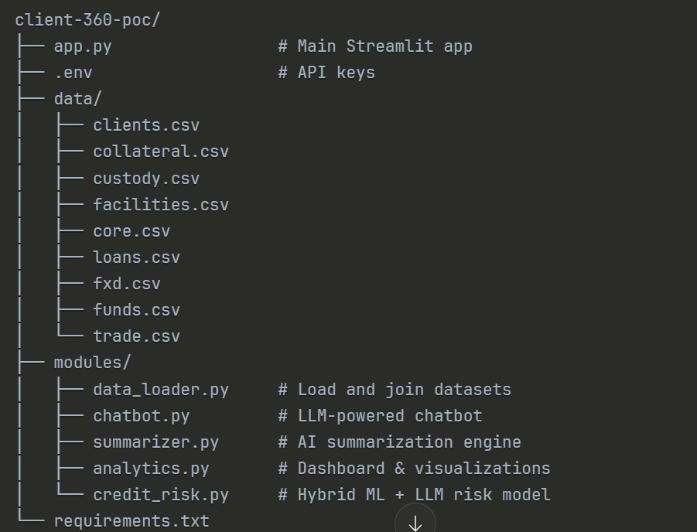
Vision Summary
Transforming Data into Actionable Insights
CONFIDENTIAL PRESENTATION DETAILS
13

